Slide 1
Games2win UI Job Description

Slide 2
Background
We have leadership in Car Driving and Parking Games! Check out:
High School Driving Test
Top 100 in USA iTunes Racing
Race to White House Trump Vs Hillary
Top 100 in USA iTunes Racing

Slide 3
Inside our games, the LEVEL SELECTION screens look like these:

Slide 4
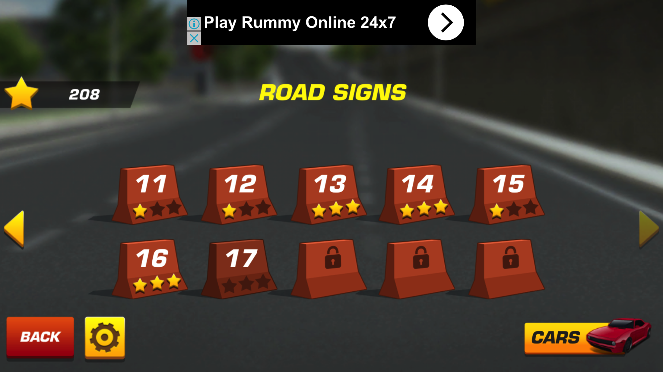
Game 2

Slide 5
Our UI Challenge
Is designing level selection screen for our Next game “Driving Academy” which is about road signs
In this game, we need to create a LEVEL design screen that combines:
Level number
AND
Road Signs in the game
See next screen for clarity

Slide 6
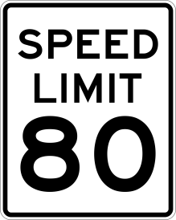
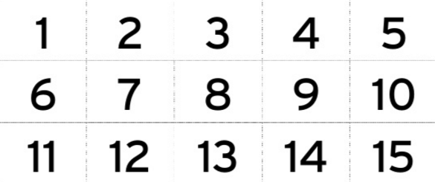
We need to combine
AND

Slide 7
We have tried creating this level selection screen UI, but were unsuccessful …

Slide 8
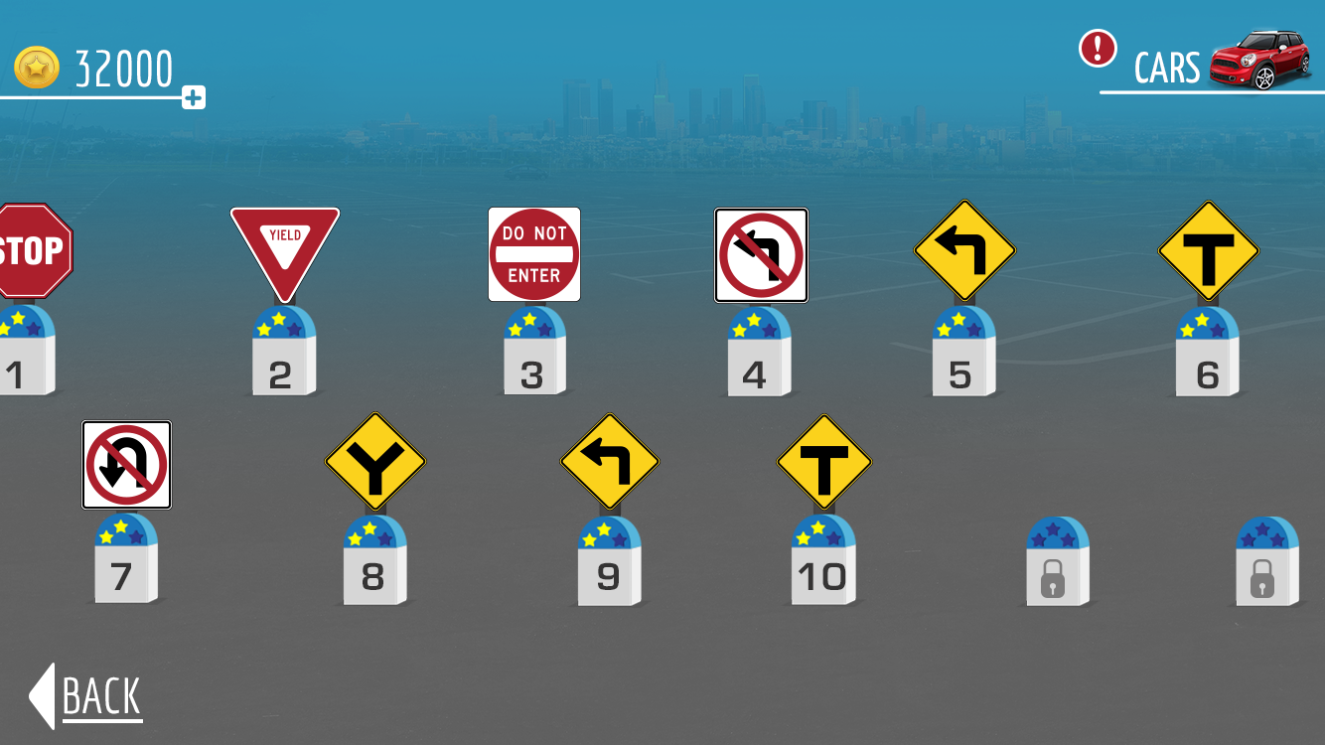

Slide 9
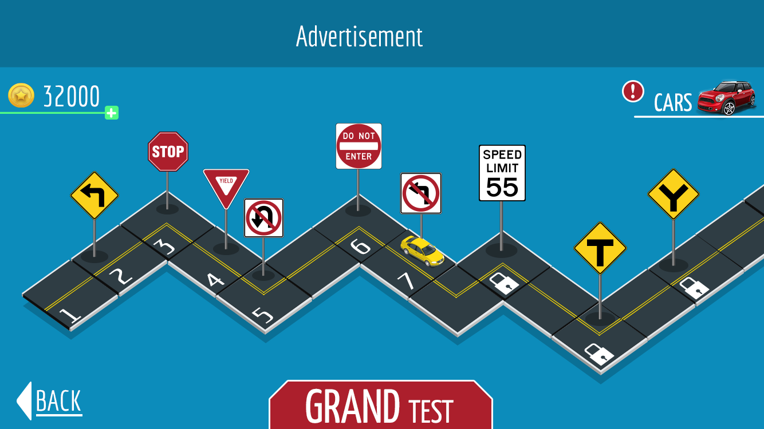
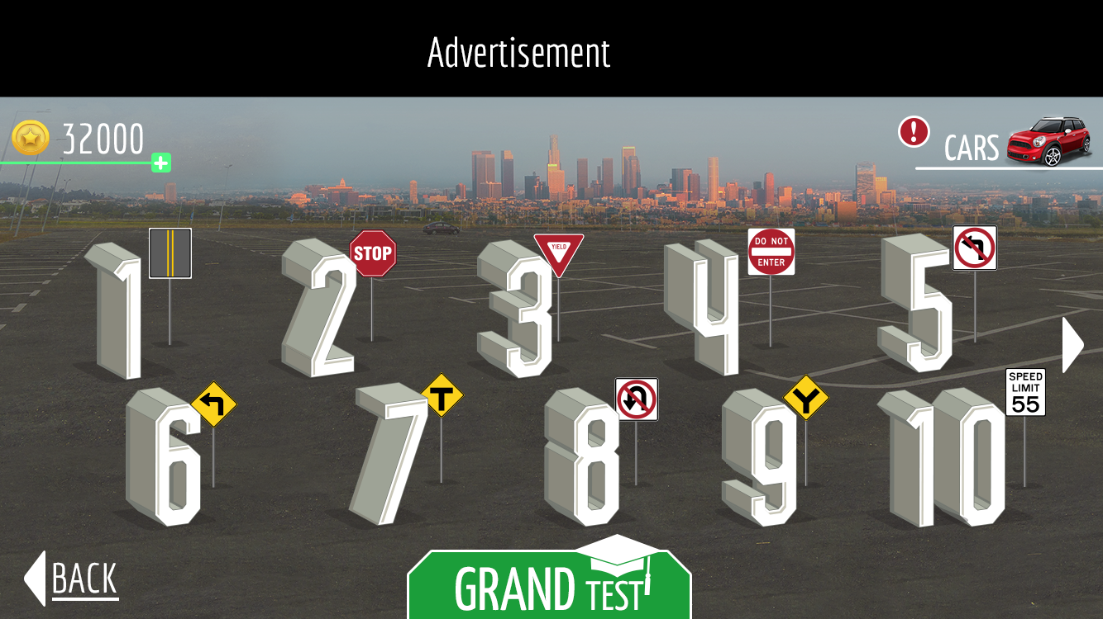

Slide 10
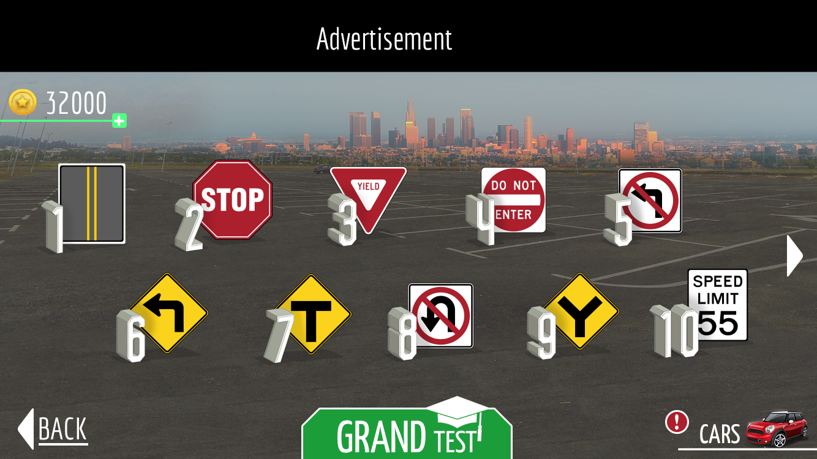

Slide 11
Please design
A level selection screen that has has 10 or 12 levels per screen (5 or 6 levels X 2 rows)
Combine the level number and the road sign in a pleasing, aesthetically pleasing manner
You can change the level selection shape the way you want as long as 5-6 are accommodated on a screen.

Slide 12
Technical Requirements
Format: Photoshop / Illustrator
Dimension: 1334 x 750 pixels
Resolution: 300 dpi
Link to download the sample Raw file
Link to download the files of Road Signs

