Slide 1
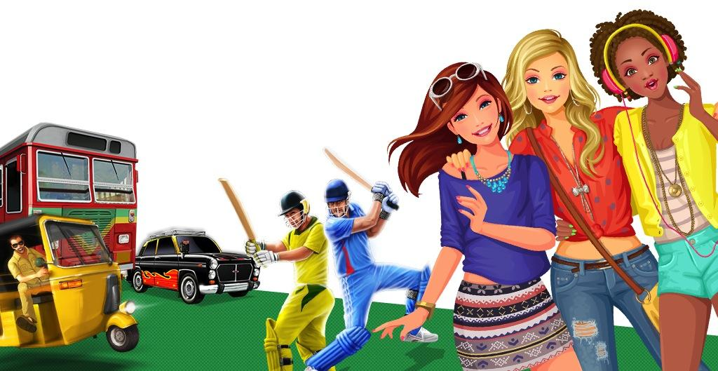
Games2win -------------------- The Great Visualization Challenge!

Slide 2
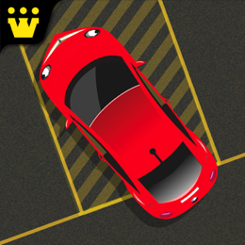
Games2win is a leading Casual Mobile Games Company!
With 97+ million mobile games downloads & adding 2 million each month!
7.0 million mobile monthly players
4.0 million unique players
50+ unique mobile titles
Including the #1 Top Ranking games like “Parking Frenzy” & “Power Cricket T20”

Slide 3
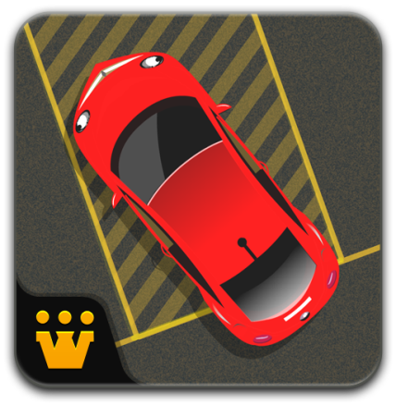
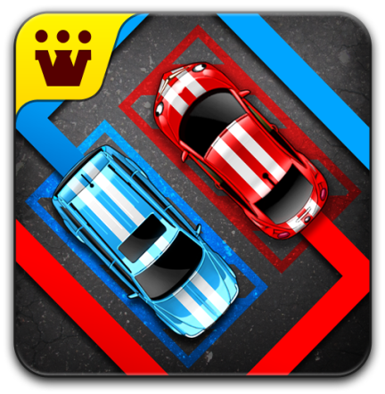
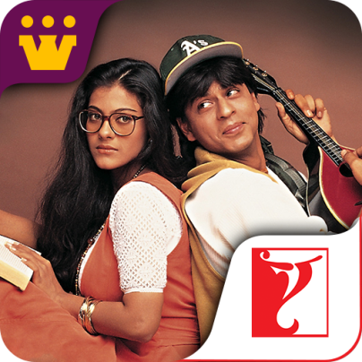
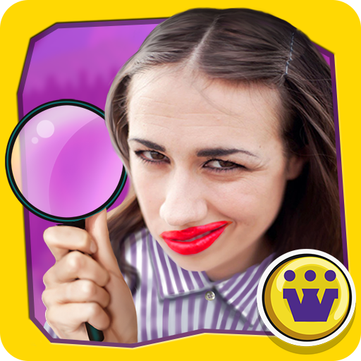
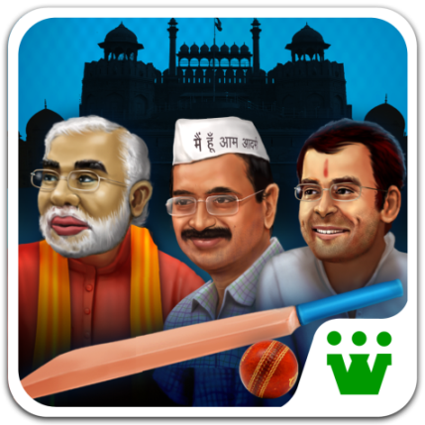
We own over 25 unique games that have ranked #1!

Slide 4
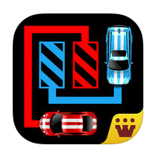
Job Description - Background
We have a great game called “Parking Puzzle”. Please download and play either the iTunes or Android game linked below:
Parking Puzzle (iTunes)
Car Parking Puzzle (Android)

Slide 5
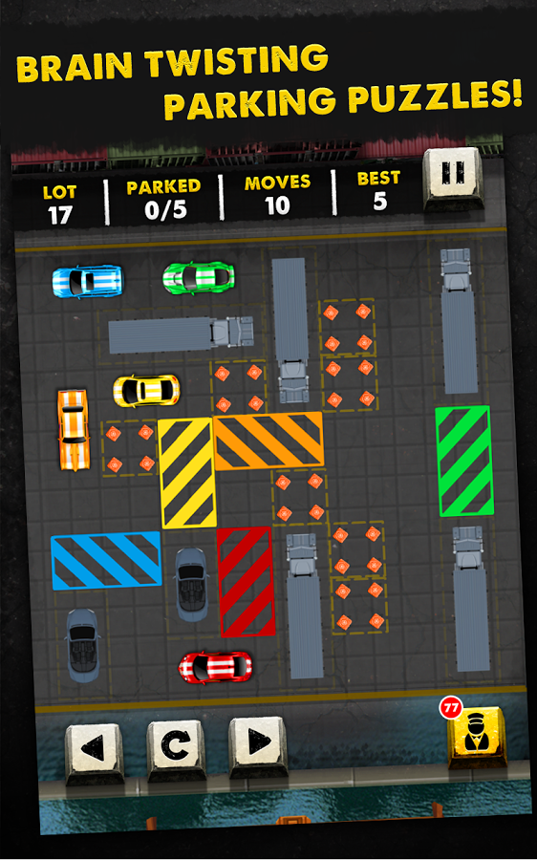
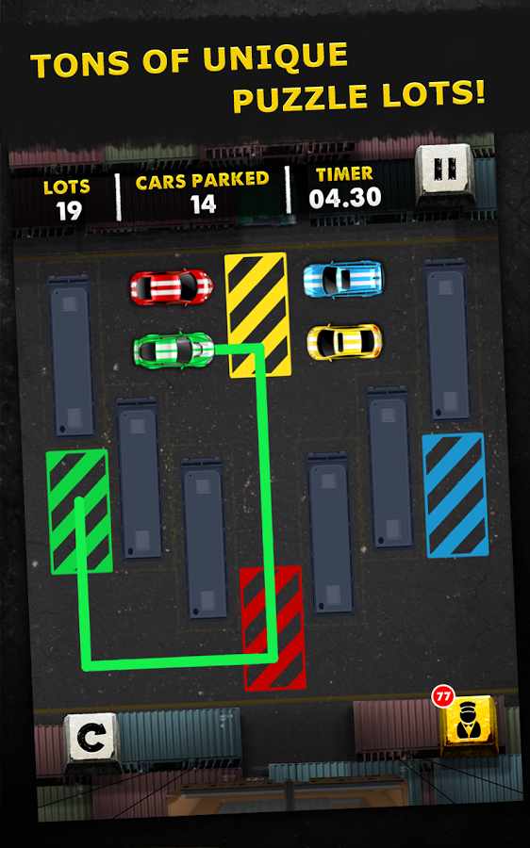
The game level and game play looks like this:
Game Play: Players need to move the colored cars into their corresponding parking lots in a certain number of turns (tries).
The puzzles become complex as the levels increase. Please download the game and experience a few levels for best understanding.

Slide 6
Our Visualization Challenge
While the game design (how the levels progress) in the game is great, the concept of parking cars in parking lots does not seem to have appealed to consumers.
The game has not been a hit or commercial success (measured by us in terms of downloads driven entirely by virality)
What we want to do is RECREATE the same game and puzzle levels with a different context – NOT cars and parking but something else.
We tried our hand at this and failed. See next slide

Slide 7
We tried creating new concepts with this puzzle format but have not been successful…

Slide 8
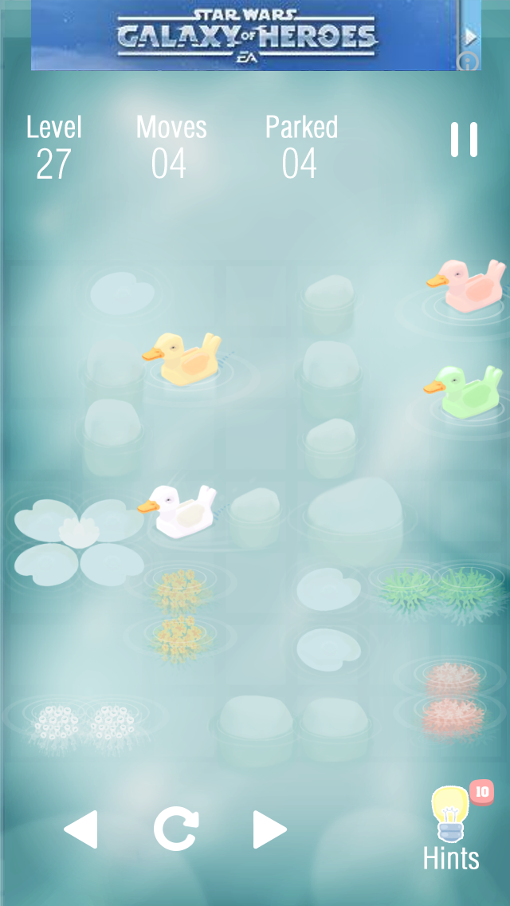
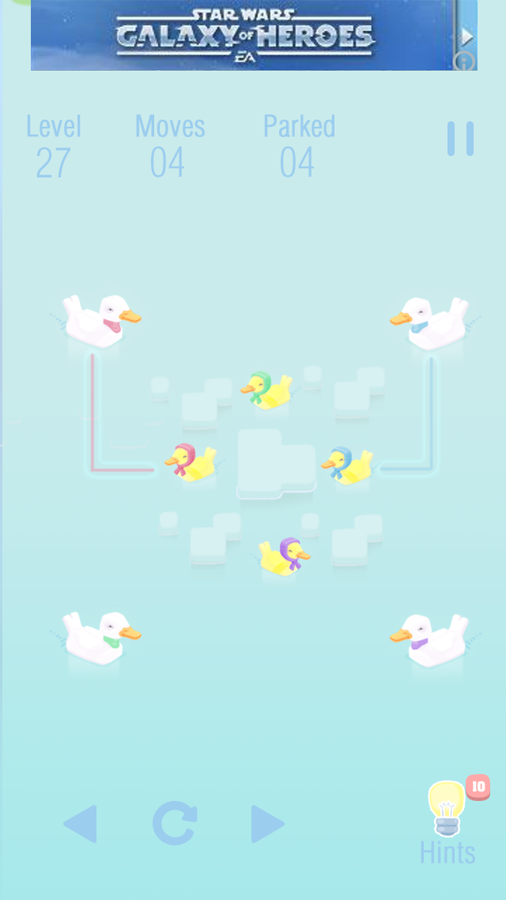
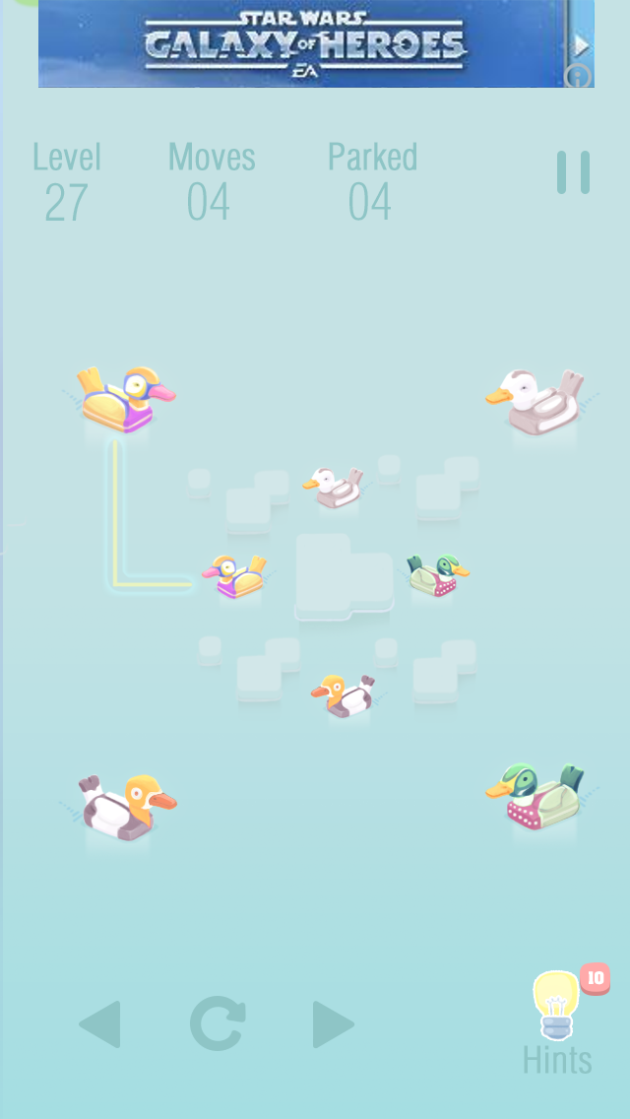

Slide 9
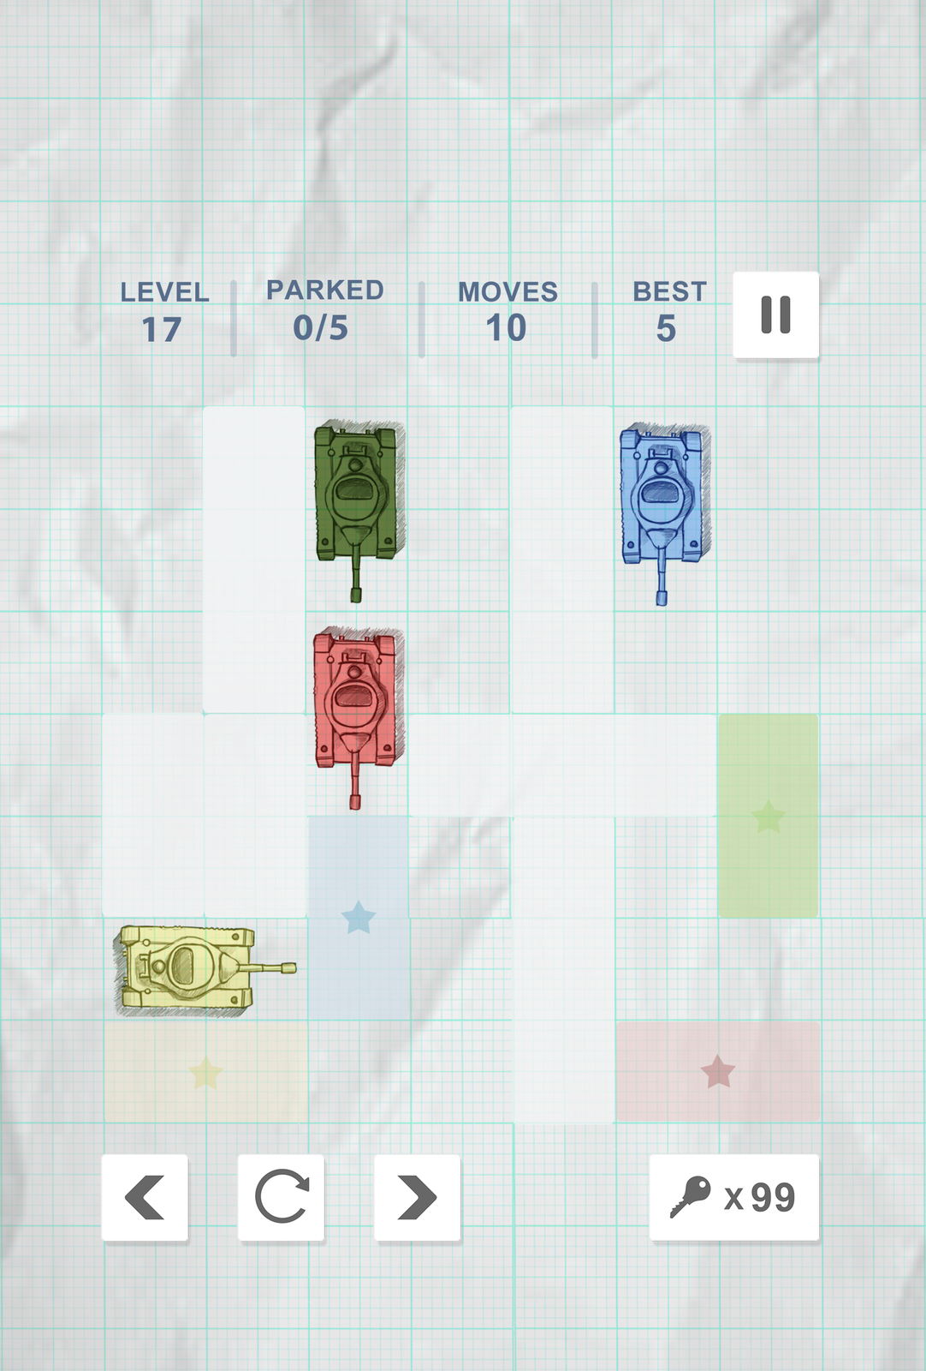
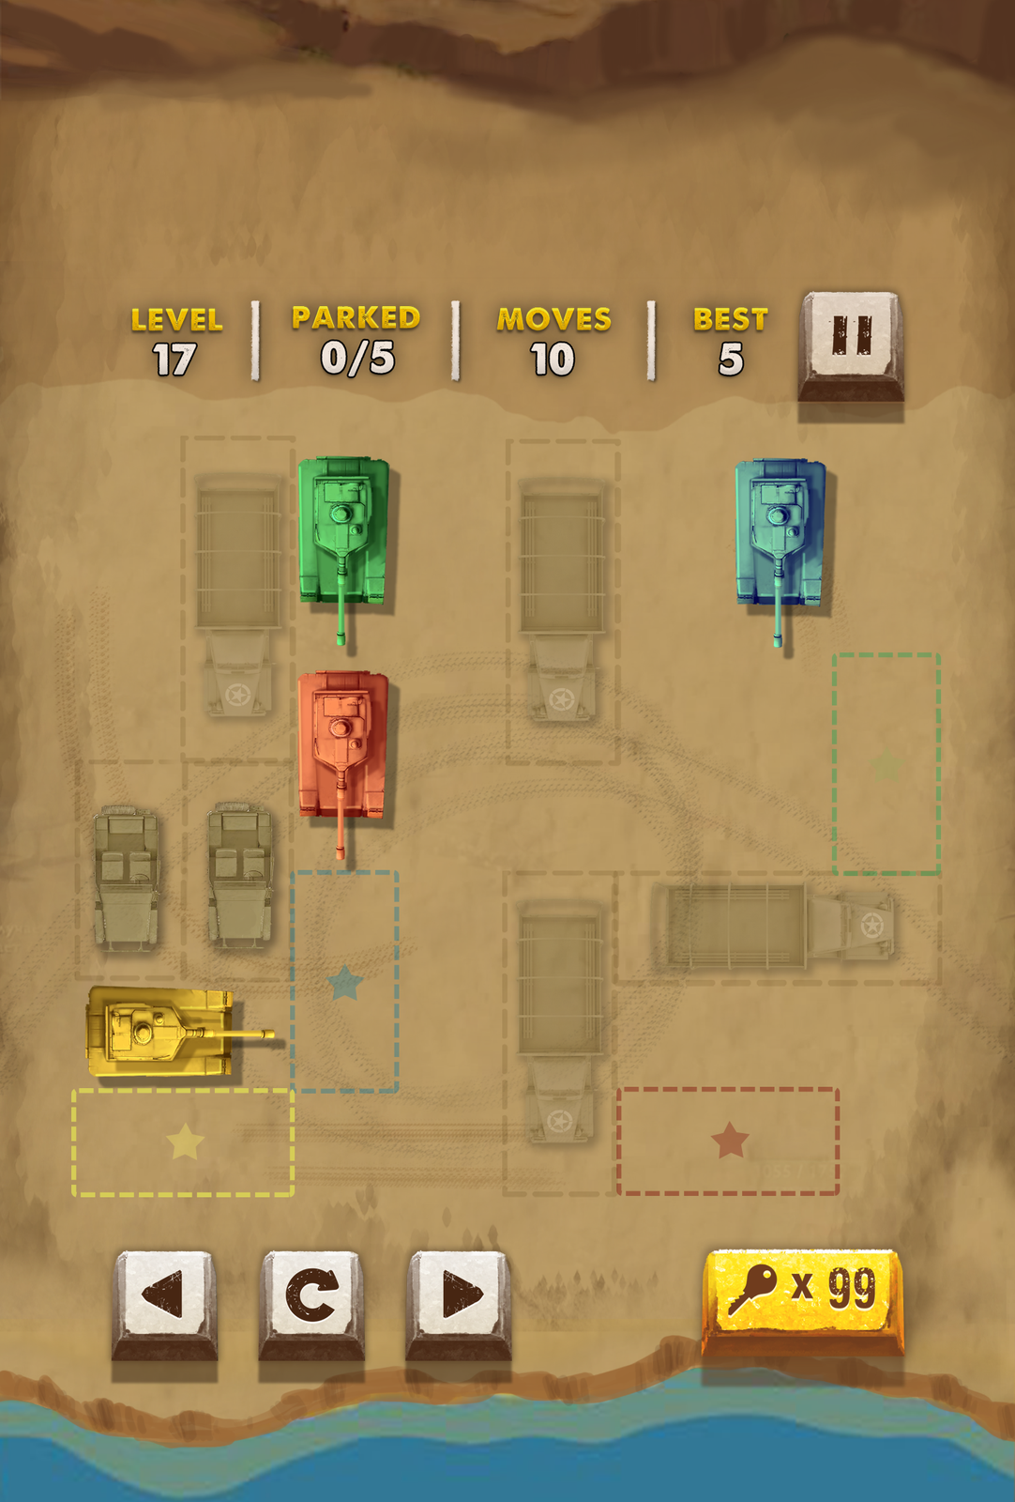

Slide 10
Please help visualize:
An alternate theme for this puzzle game that incorporates a background, assets on the screen (cars = assets) and the ‘path’ (see lines) that will show the assets moving to their designated areas.
We would like to receive concepts that are real world or any other theme that makes the consume feel naturally inclined to play level after level!
Please feel free to experiment and create themes that you believe will look great in a puzzle format. Remember – we need 4-6 unique assets to move across the vertical screen and be placed in their respective slots.

